Slide 1
AVIAN HAZARD ADVISORY SYSTEM (AHAS)
TRAINING
Florida : California : Hawaii : Calgary : London : Bejing
www.detect-inc.com www.dronewatcher.com
Copyright 2022, DeTect, Inc, All Rights Reserved

Slide 2
OBJECTIVE
Introduce users to the AHAS system by highlighting specific capabilities, common pitfalls, and best practices
1
Copyright 2022, DeTect, Inc, All Rights Reserved

Slide 3
OVERVIEW
Outputs
Current Conditions (current hour query)
Forecast Conditions (>1 and ≤ 24 hrs query)
Historical Conditions (> 24 hr query)
Risk Summary
Common Misunderstandings
Best Practices
2
Copyright 2022, DeTect, Inc, All Rights Reserved

Slide 4
AHAS
Predicts bird movements within low level flight arena for the contiguous 48 states and Alaska
Found at https://www.usahas.com
Uses Level 2 NEXRAD data, National Weather Service (NWS) Forecasts, Soaring Bird Forecast Models, and the new Bird Avoidance Model (BAM) based on NEXRAD data to predict bird movements
Provides CONUS and Alaska bird strike risk for:
IR, VR, and SR routes
Ranges and MOA’s
Some Military and Civilian Airfields
Alert Areas
NEXRAD station sample areas
3
Copyright 2022, DeTect, Inc, All Rights Reserved

Slide 5
OUTPUTS
If you request information for:
Current Hour: risk is based on observations made by the NEXRAD weather radar system, data from the Soaring Model or from the NEXBAM
Less Than 24 hrs (>1 and ≤ 24 hrs query): risk is based on the Soaring Model or the NEXBAM. These models forecast conditions favorable for hazardous bird activity to be present
More Than 24 hrs, or historical (> 24 hour query or past conditions): risk information comes from the NEXBAM
4
Copyright 2022, DeTect, Inc, All Rights Reserved

Slide 6
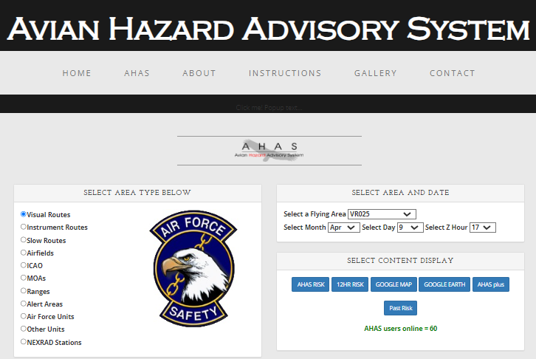
AHAS MAIN QUERY PAGE
AHAS web page tabs
AHAS immediately directs you to the query page. Check for news and other important information using the tabs at the top
AHAS allows you to select airfields based on the ICAO
To request a new unit specific page, contact the USAF BASH Team
You can also select output type
Output selection and chart option
More tabs at bottom
5
Copyright 2022, DeTect, Inc, All Rights Reserved

Slide 7
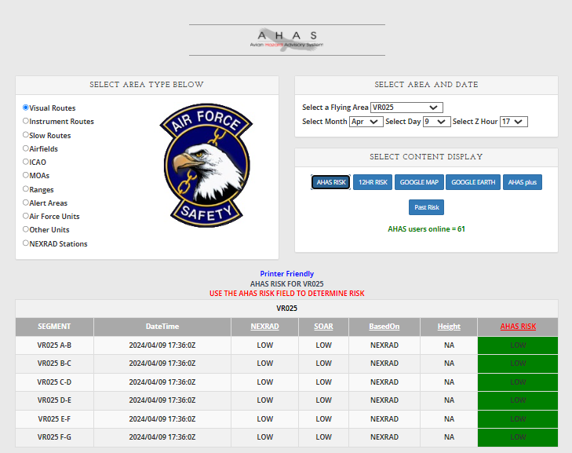
TABLE OUTPUT
1
2
3
Search Criteria: VR 025 (1, 2), current hour in Zulu (3), output choice, AHAS RISK (4)
AHAS indicates the driving model (5) for the overall risk (6), which is color coded based on risk
The results from NEXRAD will only be shown for the current hour(7)
The web page updates every 6 minutes when the data is updated in the database.
4
7
5
6
Alternate routes, Hazards and NEXBAM chart below
Copyright 2022, DeTect, Inc, All Rights Reserved
6

Slide 8
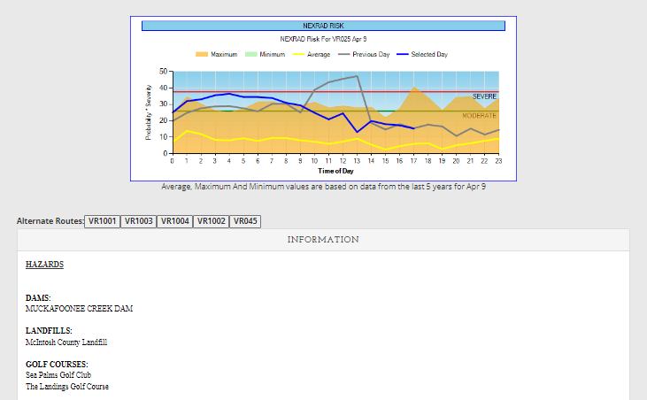
TABLE OUTPUT WITH CHART
1
The web page automatically displays the NEXBAM chart for routes and airfields (1).
To see the chart for other areas, the user must click the blue highlighted “segment” and the chart will open in another window.
The chart shows the maximum NEXRAD risk for the selected flying area for each hour. Due to the high dynamic range of the radar reflectivity data the chart uses the log10 value of the probability * severity value seen in slide 15, “Calculating NEXRAD Risk”.
The chart shows the risk for the selected day (blue line) and the previous day (gray line).
AHAS also displays the nearest five alternate routes (2).
Hazards(dams, landfills and golf courses) are also displayed (3).
2
3
6
Copyright 2022, DeTect, Inc, All Rights Reserved

Slide 9
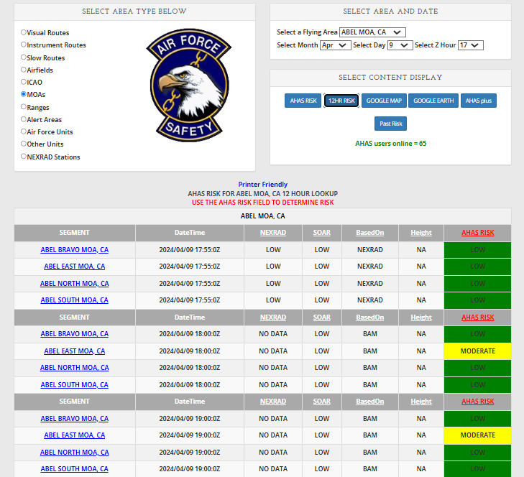
12 HOUR TABLE OUTPUT
1
2
3
Search Criteria: Abel MOA, CA(1, 2), hour in Zulu (3), output choice, 12HR RISK (4)
AHAS indicates the driving model (5) for the overall risk (6), color coded
NEXRAD risk is only available for the current hour
12 hours of risk will be shown starting at the selected hour
Scroll down for more hours
No hazards or alternate routes are shown on the 12 hour web page
The chart for the current day will appear below for routes and airfields. Click the blue highlighted segment to see the chart for other areas (7).
4
5
6
7
6
Copyright 2022, DeTect, Inc, All Rights Reserved

Slide 10
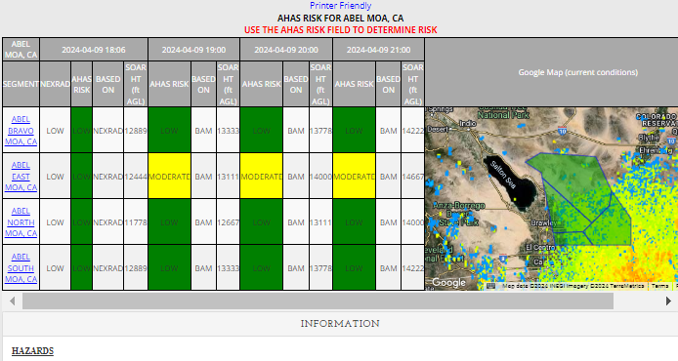
AHAS PLUS
Selected hour information
NEXRAD RISK, AHAS RISK, BASED ON, SOAR HT.
AHAS plus table opens in a new window
Hazards and alternate routes will still display (not shown)
Displays selected hour and the next 3 hours
NEXRAD risk is only available for the current hour
Shows driving model and overall risk (color coded) for all 4 hours
Shows selected area and NEXRAD data in Google Map display
Next 3 hours
6
Copyright 2022, DeTect, Inc, All Rights Reserved

Slide 11
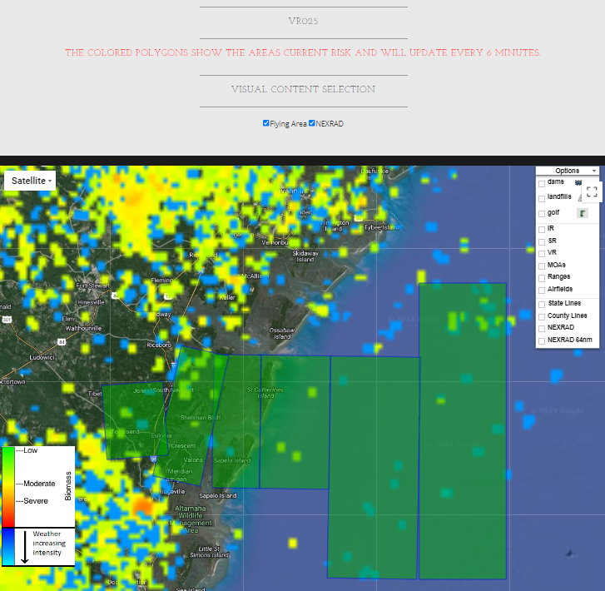
MAP OUTPUT
Google Map is available for unit- specific pages, but they may be very slow depending on the number of areas.
Search Criteria: VR025, route color based on current risk. Automatically updates every 6 minutes (1).
Standard Google Map features include pan, zoom and map view or satellite view(2).
Various layers available in the “options” drop down box (3).
NEXRAD imagery available for stations within range (4).
3
2
4
1
6
Copyright 2022, DeTect, Inc, All Rights Reserved

Slide 12
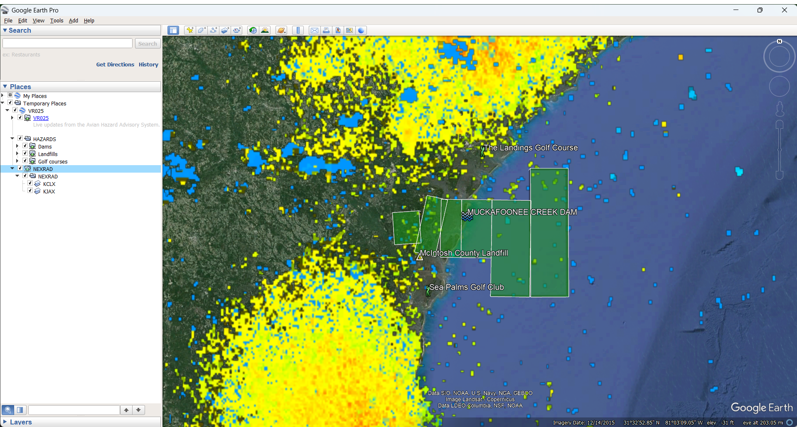
GOOGLE EARTH OUTPUT
Search Criteria: VR025, current hour
Risk matches table results and auto updates every 6 minutes
Hazards can be turned on or off, ON in this image (1)
NEXRAD station data can be turned on or off for each station in range. On in this image (2)
Route segment color defines warning level
Green = Low
Yellow = Moderate
Red = Severe
1
2
6
Copyright 2022, DeTect, Inc, All Rights Reserved

Slide 13
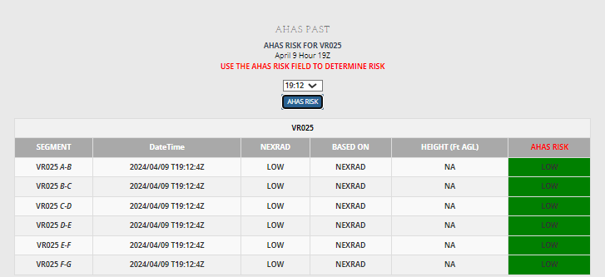
AHAS PAST
Search Criteria: VR025, hour 19
Use the dropdown box to select the specific time within the hour (1).
Results show the same fields as the standard AHAS risk request.
1
6
Copyright 2022, DeTect, Inc, All Rights Reserved

Slide 14
RISK DETERMINATION
The AHAS risk is determined based on the highest risk between the soaring model and the NEXRAD risk
If both the NEXRAD risk and the soaring data are not available, the AHAS risk will be based on the NEXBAM
If only the NEXRAD risk is missing the risk will be based on the highest risk between the soaring model and the NEXBAM
If only the soaring data is missing, the AHAS risk will be based on the NEXRAD risk
Missing NEXRAD data will be indicated on the web page as “NO DATA” in the NEXRAD column
Missing soaring data will be indicated on the web page as “NO DATA” in the Height column
4
Copyright 2022, DeTect, Inc, All Rights Reserved

Slide 15
CURRENT HOUR QUERY
Current Condition Query
Uses NEXRAD weather radar system (updated every 6-10 minutes) to monitor large-scale migratory bird activity in the CONUS and Alaska
Includes risk from soaring bird activity
Risk displayed defaults to the most severe prediction model (NEXRAD or Soaring)
Displayed thermal depth height offers maximum altitude and below where conditions are optimal for hazardous soaring birds to be present
May use NEXBAM data if the NEXRAD risk is missing
“Based On” field indicates primary source of risk
4
Copyright 2022, DeTect, Inc, All Rights Reserved

Slide 16
CURRENT HOUR - NEXRAD
Operational Risk Management
AHAS uses two factors to calculate NEXRAD risk: “Severity” is based on the dBZ (decibels of Z, where Z represents the energy reflected back to the radar) and the “Probability” of a bird strike (percentage of area polygon filled with biological activity)
AHAS calculates NEXRAD risk by multiplying Severity and Probability to get a value in the below table (Green = Low, Yellow = Moderate, and Red = Severe)
Any value <= 300 is low risk and > 4000 is severe risk
 | Probability
Severity (z) | 20 | 40 | 60 | 80 | 100
3 | 60 | 120 | 180 | 240 | 300
10 | 200 | 400 | 600 | 800 | 1000
30 | 600 | 1200 | 1800 | 2400 | 3000
100 | 2000 | 4000 | 6000 | 8000 | 10000
300 | 6000 | 12000 | 18000 | 24000 | 30000
9
Copyright 2022, DeTect, Inc, All Rights Reserved

Slide 17
CURRENT HOUR QUERY
Query Example – Bob Sikes
Go to www.usahas.com
Click desired area (1, Airfields)
Select Bob Sikes(2), current hour in Zulu (3), and output format (4)
Note: Airfield Category predicts conditions above and in a 5 nautical mile radius around the airfields and not on the fields themselves
Actual airfield conditions should be determined by observed conditions and relayed through BWC
2
3
1
4
9
Copyright 2022, DeTect, Inc, All Rights Reserved

Slide 18
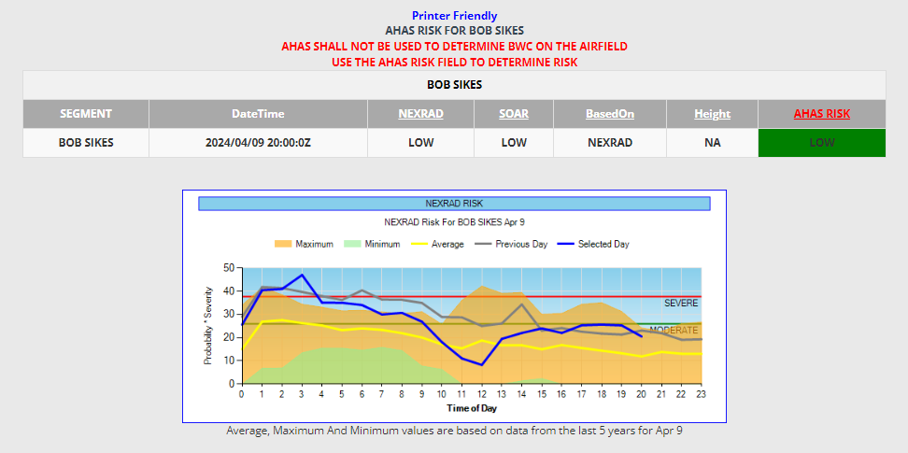
CURRENT HOUR QUERY
NEXRAD column shows the current NEXRAD risk. “NO DATA” indicates that the radar is down or the selected hour is not current
Based On column indicates which data is driving the risk reading; in this case, NEXRAD data
Overall AHAS risk driven by highest risk model. NEXRAD data overrides any ties. Cell is color coded based on risk
Height column shows the max altitude (AGL) where soaring birds might be present. In this case, “NA” indicates that the risk is not based on the soaring model. “NO DATA” indicates that the soaring data is missing
The chart shows the previous days NEXRAD risk(gray line) compared to today’s risk(blue line). As well as the min, max and average risk from the past five years of NEXRAD data.
6
Copyright 2022, DeTect, Inc, All Rights Reserved

Slide 19
FORECAST QUERY
(>1 and up to 24 hours)
Forecast Conditions Query
NWS weather observations and population data for five species of soaring birds are used to predict soaring bird risk in the contiguous 48 states and Alaska
Soaring models are run twice a day, at 0600 and 1800 to forecast bird strike risk up to 24 hours in advance
Thermal depth is calculated using the Model Output Statistics(MOS) data from NOAA and the Upper Air(UPA) weather data provided by the University of Wyoming
The species in the soaring model are turkey vultures(TUVU), black vultures(BLVU), red-tailed hawks(RTHA), bald eagles(BAEA) and golden eagles(GOEA)
The Soaring Bird Model predicts likelihood of soaring birds based on thermal depth and population data
Displayed thermal depth height indicates where conditions are right for soaring birds to be present
4
Copyright 2022, DeTect, Inc, All Rights Reserved

Slide 20
FORECAST QUERY
(>1 and up to 24 hours)
Query Example – Aberdeen Fld
Go to www.usahas.com
Click desired area (Airfields)
Select Aberdeen Fld, desired time, and select output format
Everything is the same as a current hour query except you select a time between 1 and 24 hrs from current time
Next hour selected
4
Copyright 2022, DeTect, Inc, All Rights Reserved

Slide 21
FORECAST QUERY
(>1 and up to 24 hours)
Outside of the current hour, NEXRAD data is not available
Based On column indicates which model/input is driving the risk reading; in this case, SOAR
Query is from between 1 and 24 hours of the current time
Height column shows the max altitude (AGL) where soaring birds might be present. In this case, “694” indicates that conditions are right for soaring birds to be present up to 694’ AGL and below
4
Copyright 2022, DeTect, Inc, All Rights Reserved

Slide 22
HISTORICAL QUERY
(24 hours or past)
AHAS risk prediction reverts to the NEXBAM if:
Query is for a time prior to the current month
Query is for time period >24 hrs in advance of the current hour
Other data sources are unavailable
Past data for the current month is now available on the web page
Past data older than the current month can be requested from the USAF BASH Team
4
Copyright 2022, DeTect, Inc, All Rights Reserved

Slide 23
HISTORICAL QUERY
(24 hours or past)
NEXRAD BAM(NEXBAM) data is based on:
NEXBAM risk is based on 5 years of NEXRAD data
The minimum risk value, maximum risk value and average risk value are calculated for every hour. These values can be seen in the chart display
The average hourly risk is used for the NEXBAM
For routes, the hourly risk is based on all segments.
For ranges and MOAs with multiple areas, each area is calculated separately.
4
Copyright 2022, DeTect, Inc, All Rights Reserved

Slide 24
RISK SUMMARY
The NEXRAD risk only applies to the current hour. The NEXRAD data shows the bird activity within the last 6-10 minutes. So that is the most accurate data. There is no way for the NEXRAD data to project what might be happening any time in the future.
NEXRAD data is designed to remove static targets. That's why it doesn't show mountains and buildings, etc. Soaring birds are static targets when they are riding thermals. The soaring model was added to cover that weakness in the NEXRAD data. So even in the current hour, if the soaring risk is higher than the NEXRAD risk, the soaring risk takes precedence.
If the current risk for any area is low based on NEXRAD, that also means that the soaring risk is low. The NEXBAM will only be used in the current hour if the NEXRAD data is missing. If the NEXRAD data is missing, AHAS will use the highest risk between the soaring risk and NEXBAM risk.
For any hour beyond the current hour, the AHAS risk will be based on the highest risk between the soaring model and the NEXBAM.
You cannot look at hours that have passed, beyond the current month. When you look at a time period that has already passed, you are really looking at that time period next year and all you will get is the NEXBAM risk.
The chart can show the trend of the NEXRAD risk based on the NEXRAD risk from the previous day.
The chart can show trends based on past data even when looking at months other than the current month.
4
Copyright 2022, DeTect, Inc, All Rights Reserved

Slide 25
COMMON MISUNDERSTANDINGS
Misperception: historical data from AHAS contains forecasted or current hour data
Requested historical data prior to the current month is from the NEXBAM only
Using AHAS to determine Bird Watch Condition code
AHAS uses NEXRAD data to get the risk for a 5 nautical mile (nm) radius around the airfield and is not intended to determine the Bird Watch Condition code.
4
Copyright 2022, DeTect, Inc, All Rights Reserved

Slide 26
BEST PRACTICE
Use the chart displayed for the selected time period when acquiring route times
Adjust/modify routes based on AHAS forecasts
Use the Google Map display in conjunction with NEXBAM chart during planning
Pinpoint wildlife attractants along route of flight
Identify NEXRAD coverage areas or nearest radar to route
Access AHAS just prior to step time
Incorporate ops procedures in local BASH plan
Call SOF/Sqdn Ops to get current AHAS reading prior to base departure, low-level segments, or when approaching airfield/training area
Utilize Unit Specific AHAS Web Pages
4
Copyright 2022, DeTect, Inc, All Rights Reserved

Slide 27
BEST PRACTICE
(Unit web pages)
Unit Web Pages can include:
Transition bases
Flight routes
Ops and Range Areas
Specific data impacting mission
Unit Web Pages are ideal for:
Operations Supervisors
SOFs
Crews stepping to fly
Unit Web Pages can be tailored to suit user’s needs
Hazards do not display on unit web pages
4
Copyright 2022, DeTect, Inc, All Rights Reserved

Slide 28
USAF BASH Team
Mr. Dan Sullivan, Branch Chief : daniel.sullivan.26@us.af.mil, DSN 246-5674
Mr. Paul Edlund, Deputy Chief : paul.edlund.1@us.af.mil, 505-846-5674
Capt. Boss, Wildlife Ecologist : patrick.boss.1@us.af.mil, DSN 246-5848
Commercial prefix : (505) 846-xxxx
AHAS Personnel
Mr. Ron White : ahas@detect-inc.com
Florida : California : Hawaii : Calgary : London : Bejing
www.detect-inc.com
Copyright 2022, DeTect, Inc, All Rights Reserved

Slide 29
Thank you
United States
DeTect, Inc
2817 Hwy 77,
Panama City,
Florida 32405
USA
contact@detect-inc.com
Canada
DeTect Canada International Inc.
#7 – 503 Hurricane Drive
Calgary, Alberta,
T3Z-3S8
Canada
detectca@detect-inc.com
Europe
DeTect Global, Ltd
Afron House
Worthing Road, Horsham,
Sussex, RH 12 1TL
England
detecteu@detect-inc.com
China
DeTect China
818 West 3 Building, 18 Jian Guo New Ave, Dong Cheng District,
Beijing, 100005
China
detectcn@detect-inc.com
Florida : California : Hawaii : Calgary : London : Bejing
www.detect-inc.com www.dronewatcher.com
Copyright 2021, DeTect, Inc, All Rights Reserved

